Slide 1
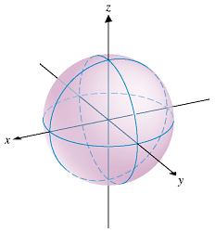
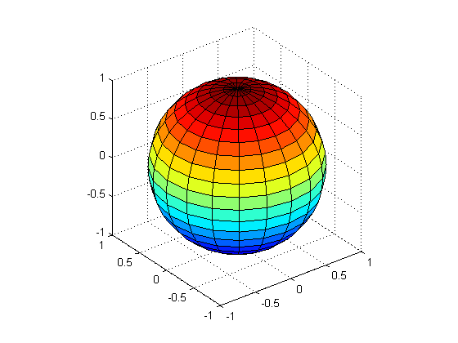
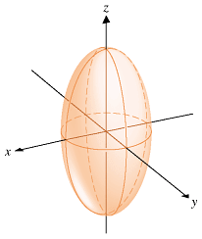
Surfaces and intersection of two surfaces
(A) Surfaces

Slide 2
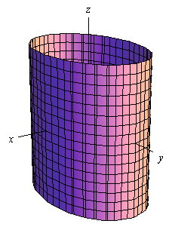
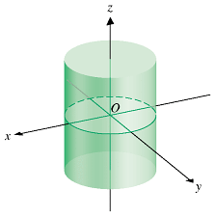
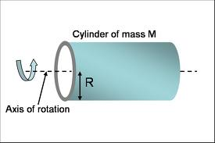
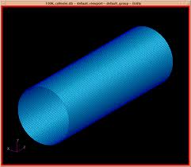
elliptic cylinder
circular cylinder
y-axis
x-axis

Slide 3
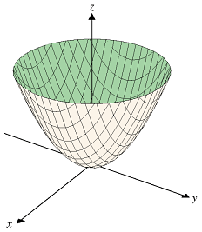
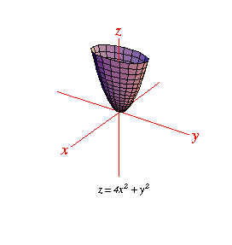
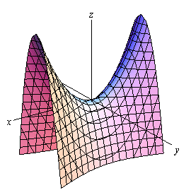
Tutorial 8 Q6

Slide 4
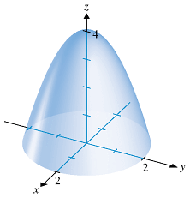
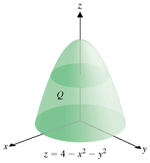
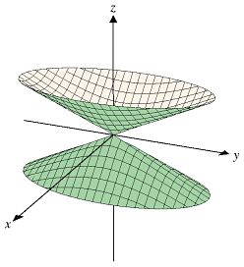
Inverted paraboloid

Slide 5
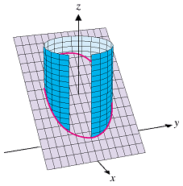
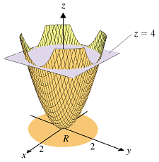
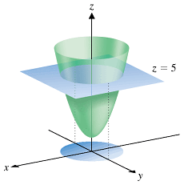
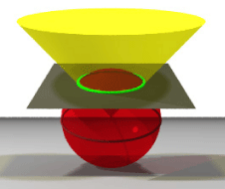
(B) Intersection of two surfaces
C is the intersection of the circular cylinder x^2+y^2 = 4 and the plane x+z = 3

Slide 6
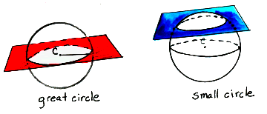
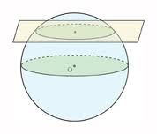
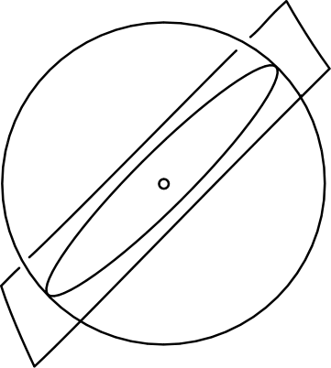
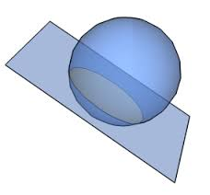
Intersection of plane and sphere is always circle

Slide 7
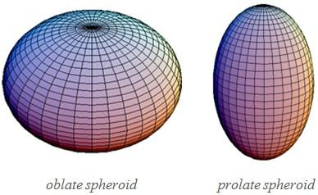
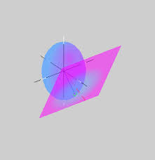
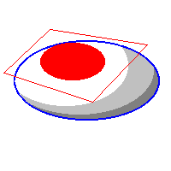
Intersection of plane and ellipsoid is always ellipse

Slide 8
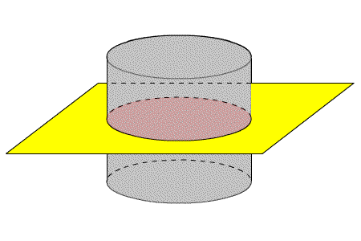
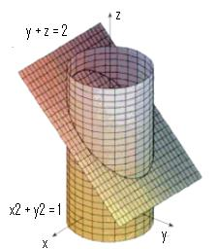
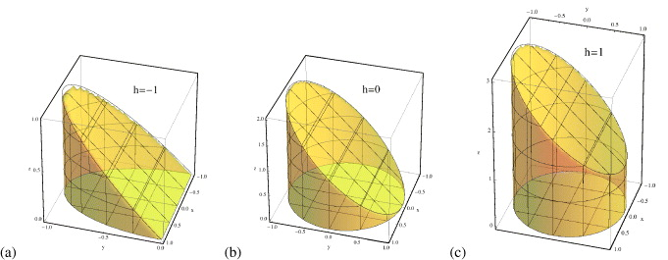
Intersection of plane and cylinder

Slide 9
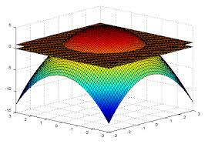
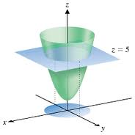
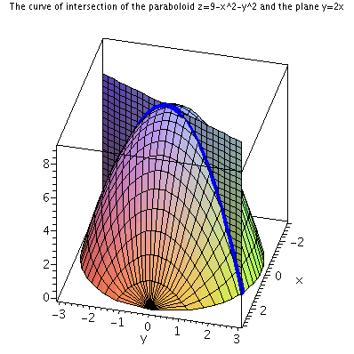
Intersection of plane and paraboloid

Slide 10
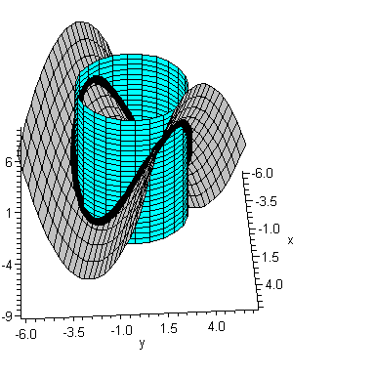
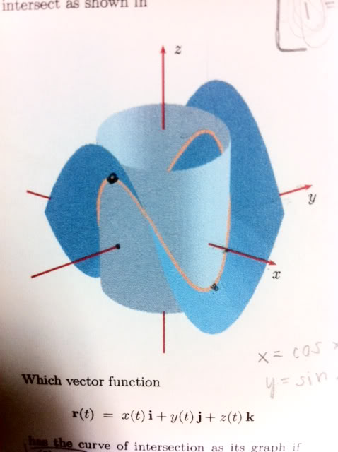
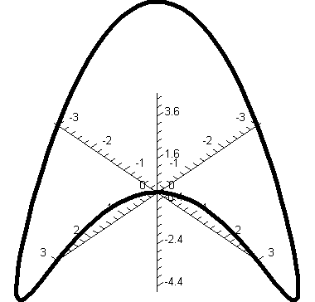
Intersection of hyperbolic paraboloid (saddle) and cylinder
surface
Tutorial 8 Q6
Surface defined
on the base
of cylinder

Slide 11
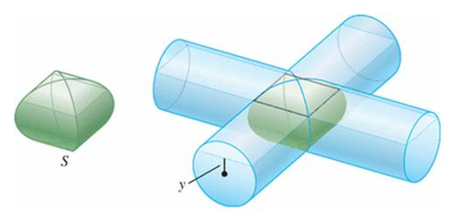
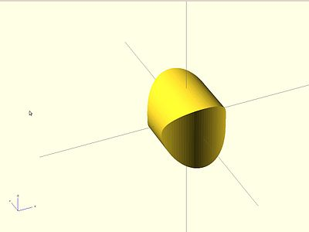
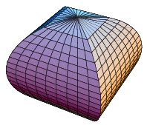
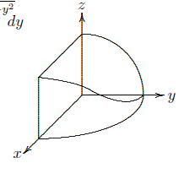
Intersection of two cylinders
Volume of the solid
8 times of the volume of this solid
Tutorial 8 Q2
http://www.math.tamu.edu/~Tom.Kiffe/calc3/newcylinder/2cylinder.html

Slide 12
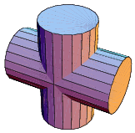
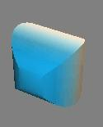
Intersection of two cylinders
animation

Slide 13
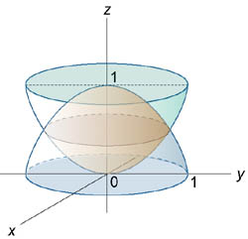
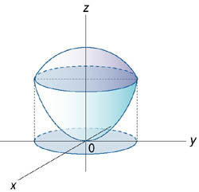
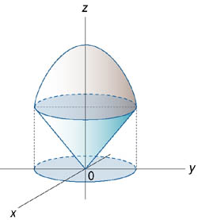
Intersection of two surfaces
The sphere x² + y² + z² = 6
and the paraboloid x² + y² = z.
The paraboloid z = 2 − x^2 − y^2
and the conic surface

Slide 14
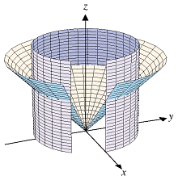
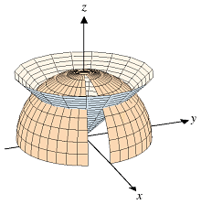
the sphere
and the cone.

Slide 15
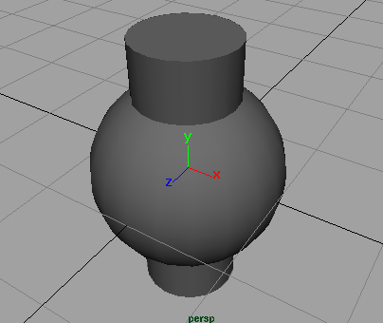
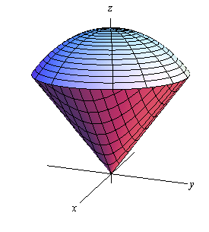
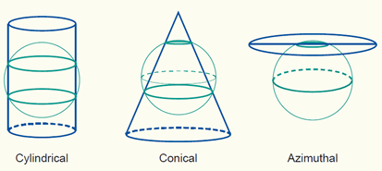

Slide 16
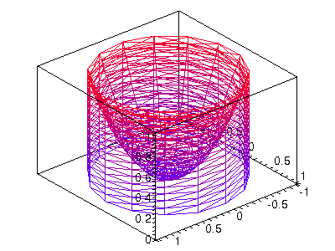
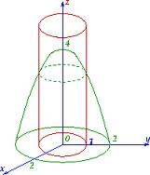

Slide 17
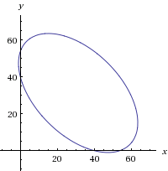
Example 1
Determine projection into x-y plane of the curve of
intersection of a plane and a sphere
Solve the above, get rid of z, we get
projection into x-y plane
which is an ellipse

Slide 18
Example 2
Determine projection into x-y plane of the curve of intersection of the following surfaces
Solve the above, get rid of z, we get
projection into x-y plane
so

Slide 19
Example 3
Determine projection into x-y plane of the curve of intersection of the following surfaces
Solve the above, get rid of z, we get
projection into x-y plane

Slide 20
Appendix
http://www.mhhe.com/math/calc/smithminton2e/cd/folder_structure/text/chap14/section04.htm
Green’s theorem
http://www.mhhe.com/math/calc/smithminton2e/cd/folder_structure/text/chap10/section06.htm
Surfaces in space
http://www.mhhe.com/math/calc/smithminton2e/cd/folder_structure/text/chap14/section03.htm
Indep of path
http://www.mhhe.com/math/calc/smithminton2e/cd/folder_structure/text/chap14/section08.htm
Stokes’ Theorem
http://www.mhhe.com/math/calc/smithminton2e/cd/folder_structure/text/chap14/section06.htm
Surface integral

